Slide 1
Do this now – write down
Write pseudocode for a program that asks the user for their age and continues to do so until they enter a valid age (0 to 150) The program should then display the user's age
Write Python code to ask the user for a number, and then print that number multiplied by 2

Slide 2
CP1404 Programming II
Subject Introduction, Programming Review

Slide 3
Overview of CP1404
Builds upon CP1401, continue developing:
Problem solving skills
Programming skills, using Python
Is the basis for the other subjects, including
CP2406 - Programming III (Java)
Introduces fundamental principles and practices of computer programming with an industry-level programming language
Start to use industry-standard tools and practices like version control with Git and GitHub

Slide 4
Knowledge and Skill Development
Apply best-practice "clean" coding techniques
Think about repeatable patterns
Object-oriented programming (OOP)
Graphical user interface (GUI) programming
Use a modern Integrated Development Environment (IDE)
Become a more efficient developer
Apply testing and debugging techniques
Use Git and GitHub for version control and code reviews

Slide 5
Assessing your skills and knowledge
Skills: develop programs written in Python (using Kivy in A2)
Assessed by: two 20% assignments, 30% practicals
Knowledge: recall and application of Python and programming concepts (including on-paper coding)
Assessed by a final exam (30%) (no mid-semester test)
Online revision tests contribute to your practical mark
Please note:
All assessment graded at an “introductory” level
All assessment is individual (no group work)

Slide 6
Contact Hours
1 x 2 hour lecture per week
Content introduction, coding demonstrations and guided in-class activities
1 x 3 hour practical per week
Based on the lecture content
Progressively introduces skills
With suggestions for at-home practice (do this!)

Slide 7
Keep up with weekly learning activities
 | Week n |  |  |  |  |  |  | Week n+1
... | Mon | Tue | Wed | Thu | Fri | Sat | Sun | Mon | Tue | Wed | Thu | Fri | Sat | ...
 | Lecture n |  |  |  |  |  |  | Lecture n+1
 | Online Test n-1 |  |  |  |  |  |  | Online Test n
 | Prac n-1 |  |  |  |  |  |  | Prac n
The prac and online test for a topic will be in the week following the lecture where that topic is introduced.

Slide 8
Academic Integrity
The goals of this subject include fundamental programming concepts and skills. Therefore, you need to develop these skills by completing the work and gaining the understanding yourself.
The subject materials contain all of the information you need for assessment. You should not use online resources (e.g. Stack Overflow or other forums) to get assistance because this would limit your learning and would mean that you would not achieve the goals of the assessment: mastering fundamental programming concepts and skills.
Note that in higher year level subjects (e.g. 3rd year), the goals will be different (since you have learned the fundamentals), so your use of resources and assistance will change (write less code yourself)

Slide 9
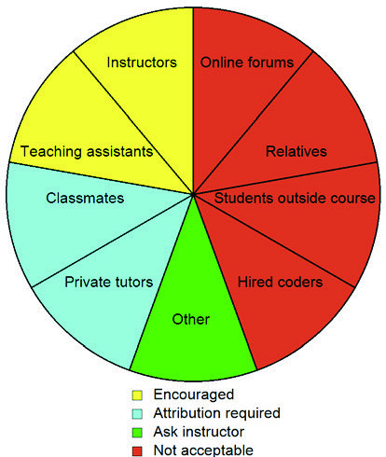
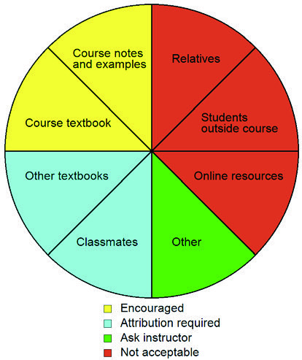
Doing your own work helps you learn
Assistance: Who can you get help from? Use this diagram to determine from whom you may seek help with your programs.
Resources: Where can you get code from? Use this diagram to determine where you may find code to use in your programs.

Slide 10
Practicals
Practicals are important for building your skills
Attempt every problem
Ask questions until you understand
Solutions are provided for practicals: https://github.com/CP1404/Practicals/tree/solutions
Super important - use these to help you learn, not to avoid learning!
Do the work yourself first, and only check the solutions to evaluate your own work - not to do it for you. OK?
If you get stuck on something and you've had a really good attempt at it, check the solution to see what to do… but don't ever copy the solutions. Do your own work. OK?

Slide 11
Practical attendance is mandatory
A student who fails to attend at least 70% of practicals from week 1 to week 10 inclusive (i.e. 7 out of 10 tutorials) must meet with the Associate Dean of Learning and Teaching and provide evidence as to why he or she should be permitted to sit the final exam or submit the final assessment task.

Slide 12
We care about style (and so do you)
In this subject, you are strongly encouraged to follow best practices and be pedantic about good, readable code.
This subject lays a foundation for your future programming development, so we will try to “get things right” from the beginning.
Do not just focus on getting code working.
It’s not OK to write code that works but has bad form and style.
Python has specific recommended conventions (e.g. PEP8) and we will follow the “rules” as closely as we can, including things like naming conventions, commenting, formatting, etc.
Assignment marking will include these conventions. It’s not just about getting something working, but learning to be really clear and correct with requirements.
… all this will make you a better programmer!
Notes:
Later on, you might relax about some of these things – but only after you have this good foundation.

Slide 13
Review of Programming Language Concepts what you should know from CP1401 (or similar experience)
A program is a list of statements
Some statements contain expressions
Most expressions contain operators
Some statements create new variables - these are called assignment statements
Some statements create new functions - these are called function definition statements
Comments are to help humans read your code - these should be simple and helpful, written for someone about your own level of understanding. Don't include comments if they don't help.

Slide 14
Beyond these, are higher-level concepts...
The class concept:
A useful way to group related variables and function
In Python, we do this using the class definition statement
The module concept:
A way to group variables, functions, and classes
In Python, each source code file is a module
Note: We cover these in a few weeks’ time! For now, let’s focus on the details of variables, statements, and function definitions in Python

Slide 15

Identify the parts in this code:
def calculate(value):
"""Double the value."""
result = value * 2
return result
print(calculate(42))
(There may be more than one and there may be others)
variable, function definition, function call, statement, comment, expression, operator, literal, parameter, docstring…
Notes:
Discuss, label/circle the names of each part – what’s what…

Slide 16
Computers, VMs, Languages…
Reference notes only…

Slide 17
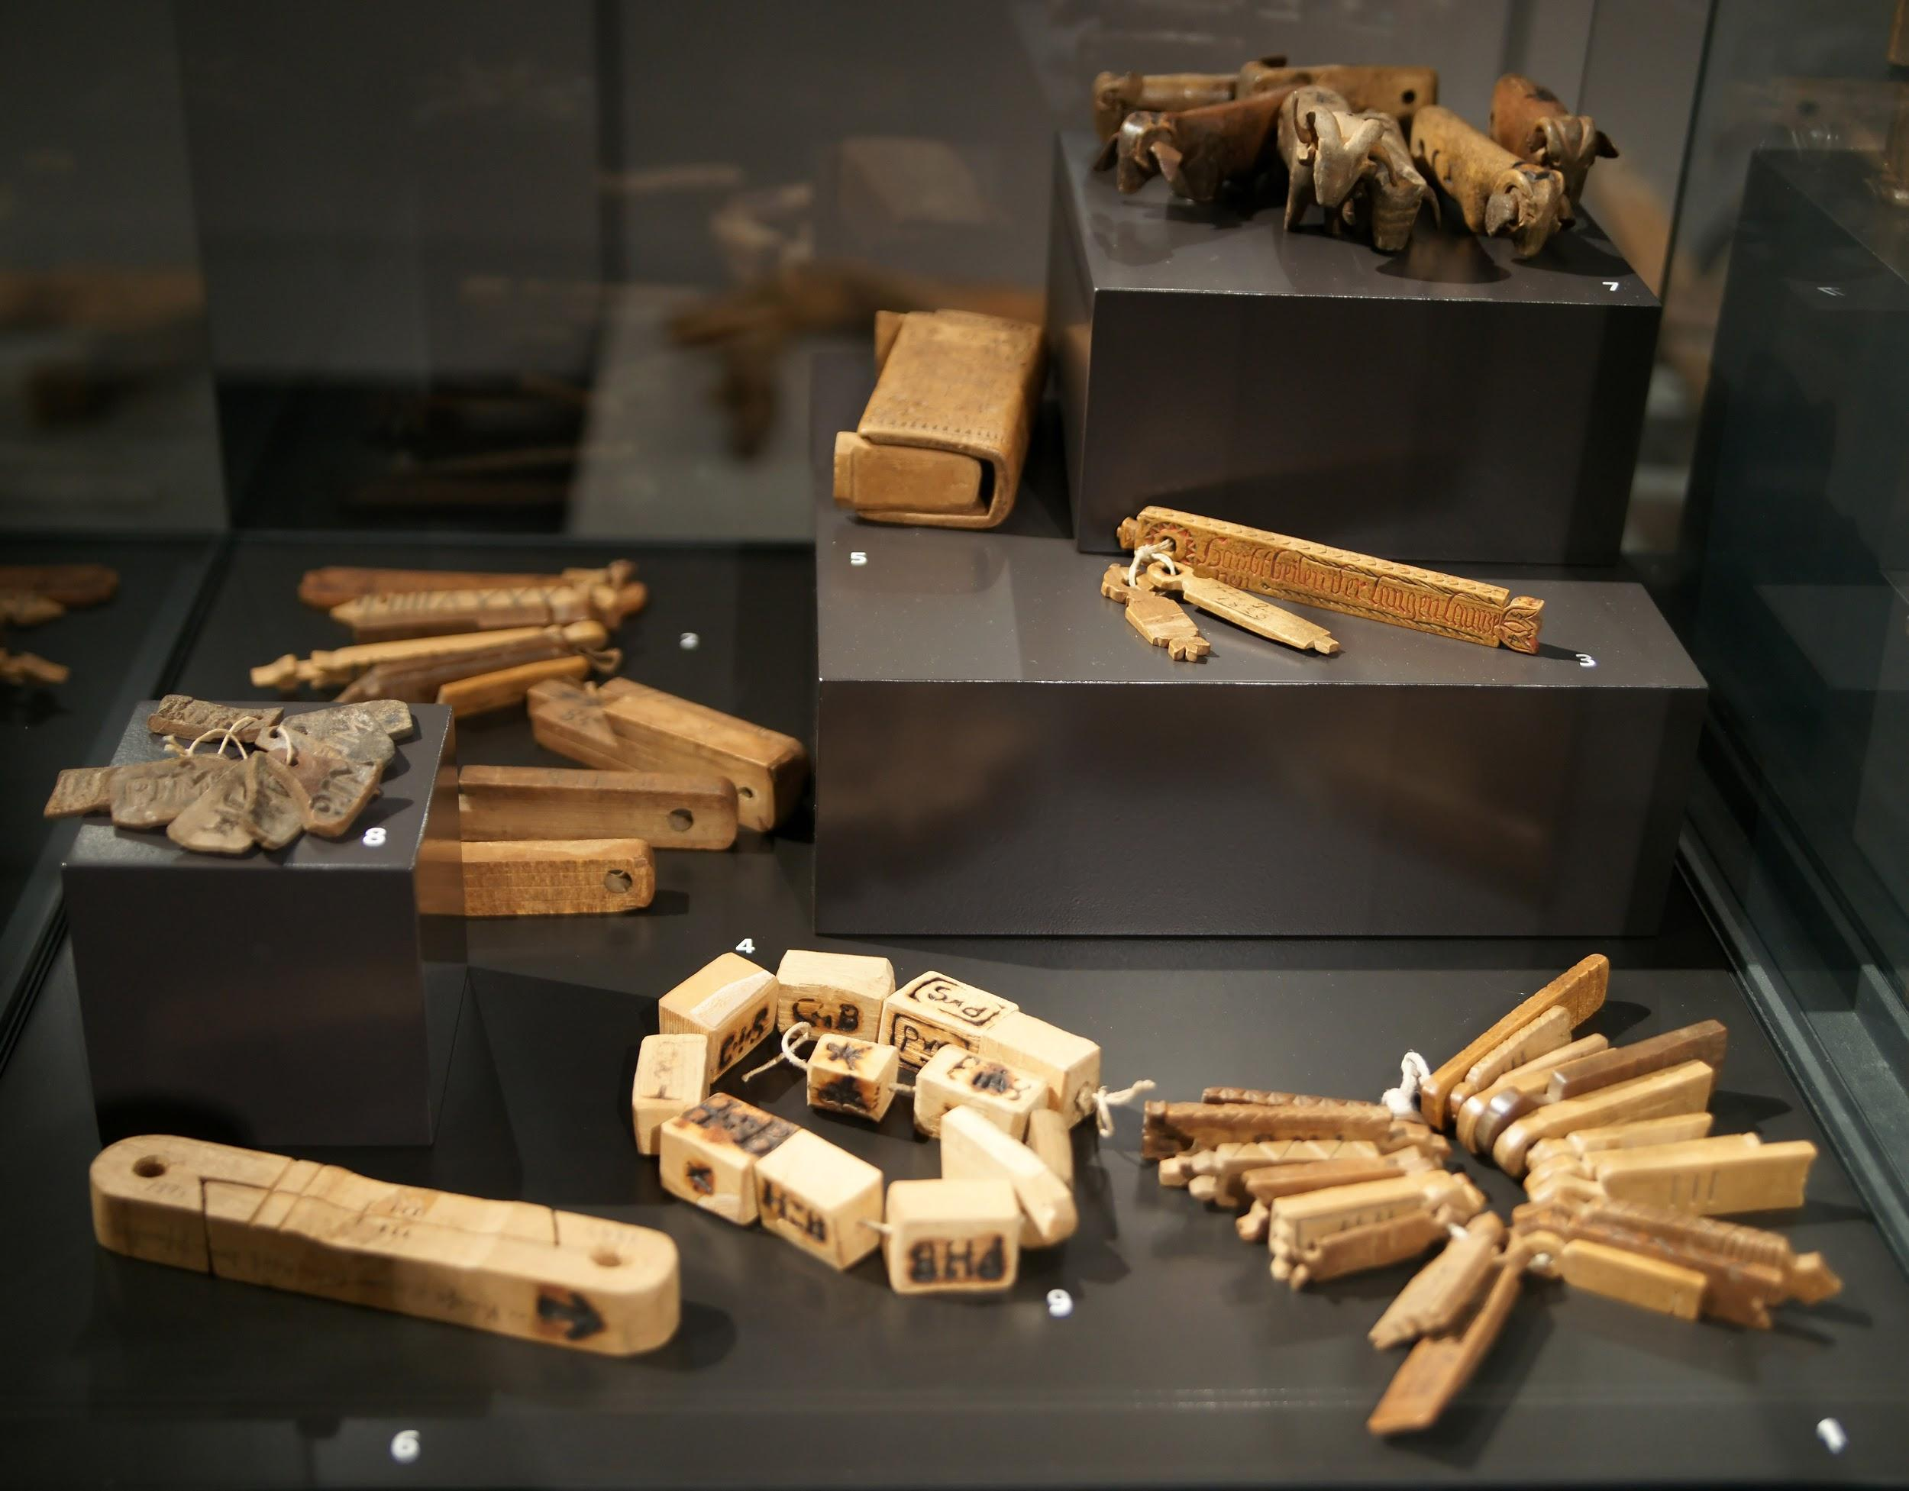
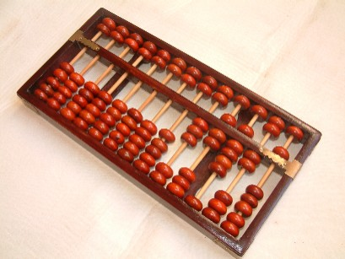
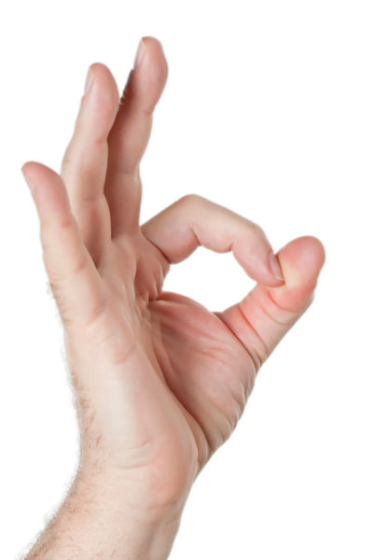
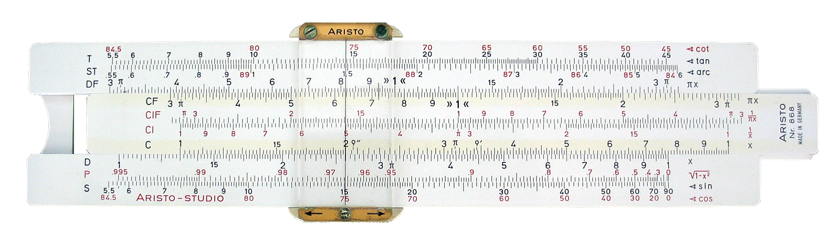
What is a computer?
Tally sticks (~19000 BC)
Abacus (~2500 BC)
Slide Rule (~1625 AD)
Notes:
The ancient notion of a computer:
A tool that helps a human performs calculations (e.g. abacus, tally-sticks, slide-rule)
The human performs a series of operations with the tool
"SAM PC 1 - Tally sticks 1 - Overview" by Own photograph by Sandstein. Licensed under CC BY 3.0 via Wikimedia Commons - http://commons.wikimedia.org/wiki/File:SAM_PC_1_-_Tally_sticks_1_-_Overview.jpg#mediaviewer/File:SAM_PC_1_-_Tally_sticks_1_-_Overview.jpg
"Sliderule 2005" by Sliderule_2005.jpg: Roger McLassusderivative work: Beao - Sliderule_2005.jpg. Licensed under CC BY-SA 3.0 via Wikimedia Commons - http://commons.wikimedia.org/wiki/File:Sliderule_2005.png#mediaviewer/File:Sliderule_2005.png

Slide 18
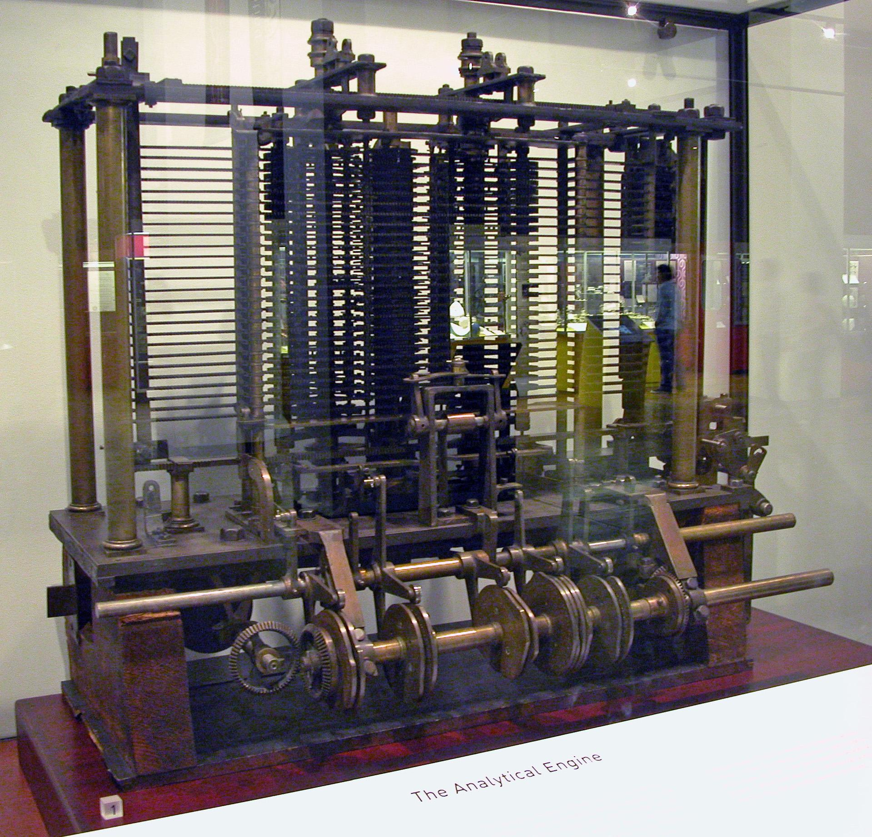
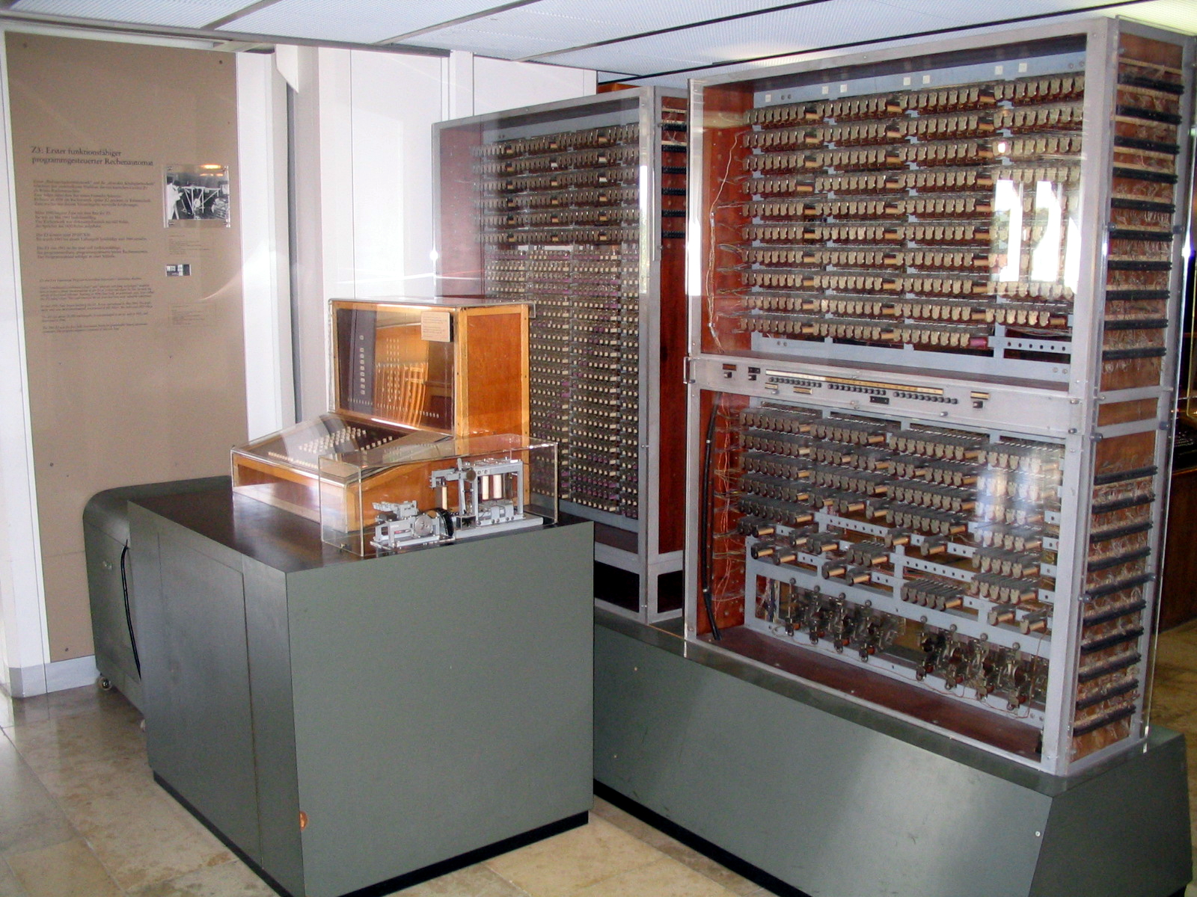
What is a computer?
Analytical Engine (~1830s)
Zuse Z3 (1941)
Notes:
The modern notion of a computer: A device that we program to automatically execute program code
Analytical Engine - mechanical computer, first general purpose computer, used punch-cards for program, uses decimal numbers
Zuse Z3 - electro-mechanical, programmed using punch film, used binary for representing numbers, and pioneered the representation floating-point numbers
"AnalyticalMachine Babbage London" by Bruno Barral (ByB). Licensed under CC BY-SA 2.5 via Wikimedia Commons - http://commons.wikimedia.org/wiki/File:AnalyticalMachine_Babbage_London.jpg#mediaviewer/File:AnalyticalMachine_Babbage_London.jpg
"Z3 Deutsches Museum" by Venusianer at the German language Wikipedia. Licensed under CC BY-SA 3.0 via Wikimedia Commons - http://commons.wikimedia.org/wiki/File:Z3_Deutsches_Museum.JPG#mediaviewer/File:Z3_Deutsches_Museum.JPG

Slide 19

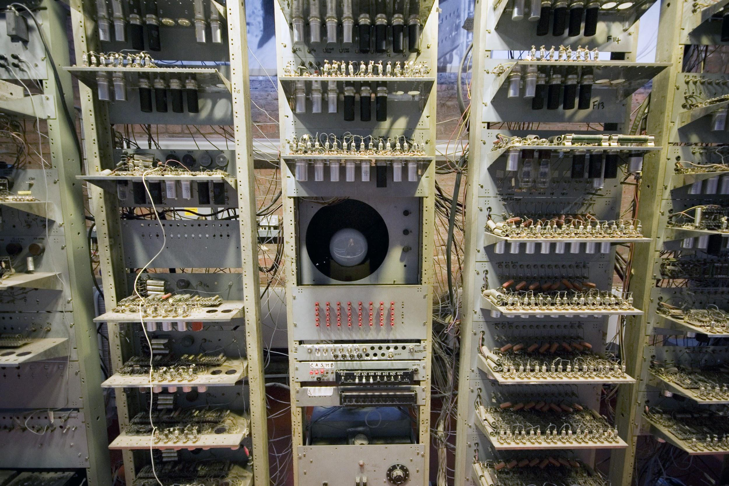
What is a computer?
ENIAC (~1946)
Baby (~1948)
Notes:
ENIAC - one of the first “turing-complete” computers, programmed by the state of its patch-cables
Baby - first stored-program computer
"Eniac" by Unknown - U.S. Army Photo. Licensed under Public Domain via Wikimedia Commons - http://commons.wikimedia.org/wiki/File:Eniac.jpg#mediaviewer/File:Eniac.jpg

Slide 20
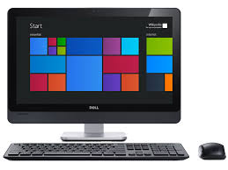

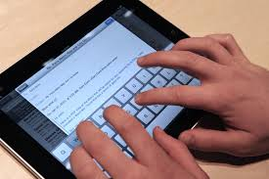
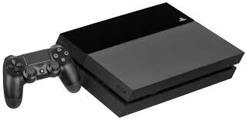
What is a computer?
Modern computers...
Notes:
Baby - first stored-program computer
"SSEM Manchester museum close up" by Parrot of Doom - Own work. Licensed under CC BY-SA 3.0 via Wikimedia Commons - http://commons.wikimedia.org/wiki/File:SSEM_Manchester_museum_close_up.jpg#mediaviewer/File:SSEM_Manchester_museum_close_up.jpg

Slide 21
A Computer is …
Ancient definition:
A specialised tool to aid humans doing calculations
The human does the work, the tool supports them
Modern definition:
A general-purpose device that performs tasks
The human programs the computer, and the computer runs the tasks automatically

Slide 22
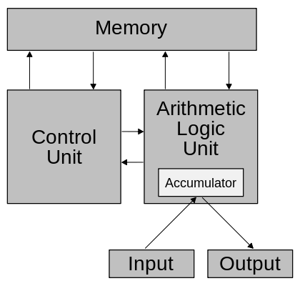
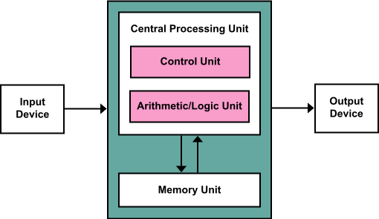
Alan Turing and John Von Neumann independently developed the “stored-program” computer architecture
But Von Neumann’s designs become well-known:
Notes:
Von Neumann’s designs appear in press before Turing’s and hence the chosen naming was “Von Neumann Architecture”

Slide 23
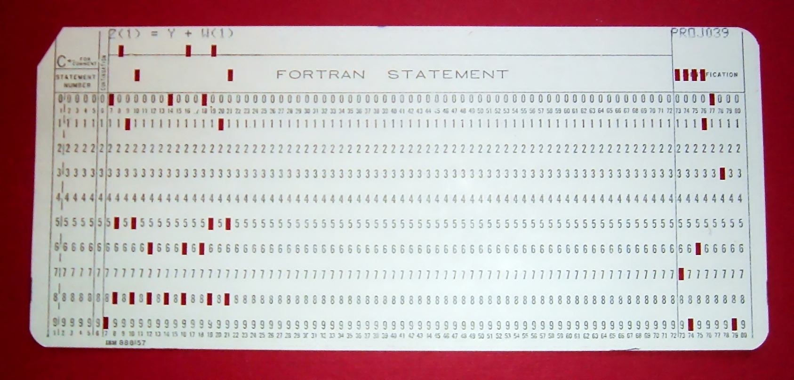
In a stored-program computer, the program
and its data are both stored in memory
Before this idea, programs were separate from the data:
E.g. punch-cards, the arrangement of cables
Notes:
"FortranCardPROJ039.agr" by Arnold Reinhold - I took this picture of an artifact in my possession. The card was created in the late 1960s or early 1970s and has no copyright notice.. Licensed under CC BY-SA 2.5 via Wikimedia Commons - http://commons.wikimedia.org/wiki/File:FortranCardPROJ039.agr.jpg#mediaviewer/File:FortranCardPROJ039.agr.jpg

Slide 24
Components of a modern computer
Memory Unit - stores program code and data
Arithmetic / Logic Unit - performs math operations
Control Unit - executes programs
Input / Output Devices
Display, Keyboard, ...
Notes:
CPU is the ALU and the CU together

Slide 25
A general-purpose modern computer understands machine code
Machine code is a set of primitive instructions for performing arithmetic and logic operations
A program can be written as machine code
The Control Unit executes machine code stored in memory using the fetch-decode-execute cycle:
Fetch the next instruction
Decode that instruction
Execute that instruction

Slide 26
What is a program?
A series of instructions that a modern computer can execute
A program allows you to tell a computer what to do
We write programs that allow us to solve problems on computer

Slide 27
What is a programming language?
It is hard to write even a simple program in machine code - humans don’t think like a computer!
As programs became more sophisticated, resolving this issue became more important
Programming languages were invented to make programming easier for humans

Slide 28
A programming language is an abstraction
Abstraction means “hide the details”
it’s a powerful and important concept in IT
Instead of machine code, a program written in a programming language is closer to how humans think
Instead of a complex sequence of machine code operations, often a single expression or statement can be used

Slide 29
History of programming
http://www.levenez.com/lang/ provides a very interesting chart of the development of 50 programming languages
Some historians recognise Ada Lovelace's work in 1842 as the world's first computer program
Herman Hollerith encoded data on punch cards (used for train tickets) around 1890
Programming languages designed to communicate instructions to a modern electronic computer were written in the 1950s
Notes:
https://en.wikipedia.org/wiki/History_of_programming_languages

Slide 30
History of programming
Languages (and their historical development) are sometimes classified in terms of their "generation"
Sometimes this is basically just marketing
It is very rough and not used much
You will find different versions around the place (not fixed)
1GL (First Generation Language) - low-level machine language
2GL - low-level assembly language
3GL - high-level languages, like C, Java, Python
4GL - similar to human language, like SQL, Visual FoxPro
5GL – constraints-based rather than algorithm-based, like Prolog

Slide 31
Different programming languages have different syntax and semantics
Syntax means “how something is written”
Semantics means “the behaviour something has”
There are many programming languages
Because different problems are easier to solve using different syntax and semantics

Slide 32
A program written in a programming language is translated into machine code
A computer only understands machine code
So programs written in a programming language must be converted into machine code
We call this “translation” - from programming language code into machine code

Slide 33
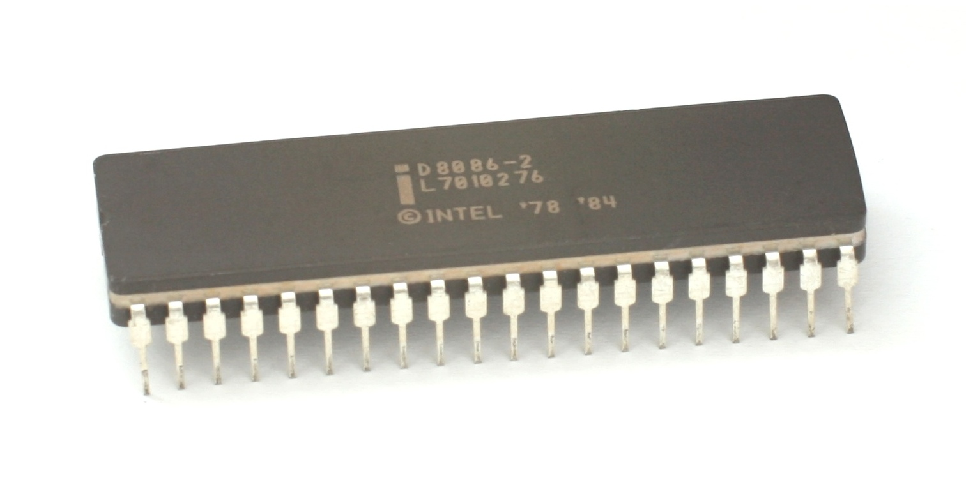
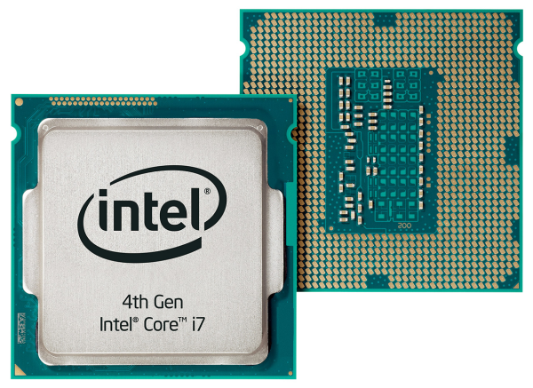
Many computers use the Intel x86 chip architecture
8086: ~1978
Haswell: ~2013

Slide 34
The x86 machine code is complex...
Code | Meaning
ADC | add with carry
ADD | add
AND | logical and
CALL | function call pushing program counter onto the stack
DEC | decrease by 1
DIV | unsigned divide
HLT | stop the computer
hundreds more...
Notes:
http://en.wikipedia.org/wiki/X86_instruction_listings

Slide 35
Python compiles to something closer to machine code called bytecode
Python code | Python bytecode
value = 1 value = value + 1 print(value) | 1 0 LOAD_CONST 0 (1) 3 STORE_NAME 0 (value) 2 6 LOAD_NAME 0 (value) 9 LOAD_CONST 0 (1) 12 BINARY_ADD 13 STORE_NAME 0 (value) 3 16 LOAD_NAME 1 (print) 19 LOAD_NAME 0 (value) 22 CALL_FUNCTION 1 (1 positional, 0 keyword pair) 25 POP_TOP 26 LOAD_CONST 1 (None) 29 RETURN_VALUE
NOTE: A Python program is translated into bytecode before it is executed on a real computer.
Notes:
For more, check out https://docs.python.org/3.4/library/dis.html

Slide 36
Answer the following questions about the Python bytecode we just looked at...
What do think the first column of numbers mean in the bytecode output?
What do you think the second column of numbers mean?
In your own words, describe the term “program translation”.
We estimate that a Python program with X lines of code will have an equivalent bytecode program of ____________ lines of code.

Slide 37


A typical program needs to: get input, process data, and output results
A program gets input from a variety of input devices
Keyboard, mouse, touch screen, sensors, ...
It then processes the inputs as data in various ways
Results are then formatted and sent to various output devices
Screen, printer, sent across the Internet, ...

Slide 38

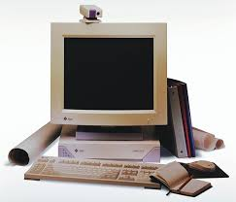

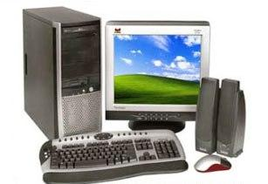
However, the reality is messy...
You have to rewrite your program to suit each type of Operating System and computer hardware - not very practical!
MyProgram
Mac-version
MyProgram
PC-version
MyProgram
SUN-version

Slide 39
One solution: simulate the functionality of OSes and hardware as a program - we call this a virtual machine
Source code
Compiled
Bytecode
runs on
Virtual machine
Operating System
Computer hardware

Slide 40
Bytecode is the machine code that runs on a Virtual Machine (VM)
When you install Python on your computer:
A computer-specific version of the VM is installed
A VM is just like any other program running on your computer...
The VM knows how to execute bytecode:
So, a program compiled into bytecode on a Mac can then be executed on Windows without recompilation!
Notes:
Generate a .pyc file from python source code on (say) a Mac, and then copy the bytecode file onto a (say) Windows computer and execute it using the same version of Python - it will run without modification!

